Slide 1
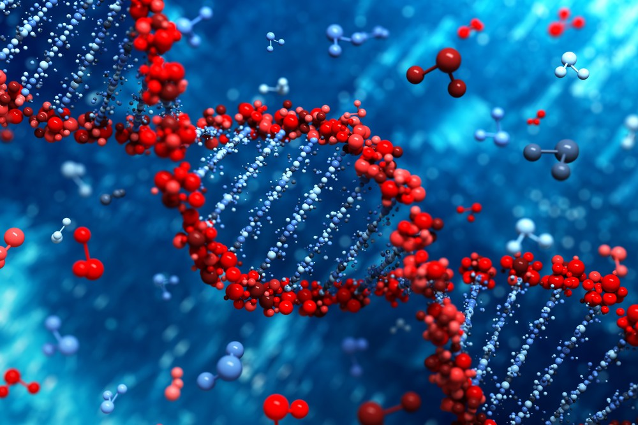
Augmenting Cancer Detection
Sreeja Pillai
U1265169
School of Computing

Slide 2
Outline
Problem Statement
Literature Review
Exploratory Data Analysis
Methods used
&
Discussion
Learnings/Conclusions
Challenges Faced

Slide 3
Problem Statement
History
Every cell in the human body has a DNA, which is responsible for building and maintaining the organism. DNA does this by sending out the code for producing certain kinds of proteins necessary for cell growth and division. DNA cannot directly send out this information to the nucleus; it uses RNA (m-RNA,t-RNA,r-RNA)for this communication So, at times the DNA mutates and sends signals to divide and grow cell uncontrolled. This causes the cell to mutate and grow; invading other tissues.
Problem Statement
In this project we are trying to explore and analyze two different datasets, one collected by doing biopsy and another using X-ray images to see if we can get almost the same accuracy in detecting cancer using data with and without biopsy.
If we can make do without biopsy , we can alleviate pain and anxiety for patients .

Slide 4
Literature Review
In this project we are exploring two datasets:
Mammography Dataset from UCI: mammography is the most effective method for breast cancer screening. But it has a high rate of false positive screening, thus causing unnecessary biopsy. Thus, we are developing CAD techniques to assist the doctors in more accurately predicting malignant tumor and thus increasing the chances of going for biopsy when it is truly needed. This dataset was collected using data from mammography done on patients, no biopsy.
CAD – Computer Aided Diagnosis are methods developed using ML, DL and AI based techniques. For this dataset they have gone with decision trees to predict cancer.

Slide 5
2. RNA-seq Gene Dataset from UCI: DNA does not always reveal the whole picture of the cancer cell growth, but RNA can. Research has showed that, the RNA profiles of cancer patient can help us learn more about the biology of cancer and on how to treat them. This dataset is gene expression of RNA sequence of various cancerous tumors. The main aim of this dataset was to discover molecular aberrations which are common or totally different among different cancer tumors and use them to predict the type of cancer it is.
This dataset was taken by doing biopsy on many patients with different class of cancers.
This dataset was built for myriad of uses, we will be using it to see how useful/accurate data is collected using biopsy for predicting cancer.

Slide 6
Exploratory Data Analysis
Replace categorical with mode
Numeric with mean
SMOTE
yes
Yes
Data
Null Values
Correlation
Imbalance
encoding
no
no
Shape : 801*20532(RNA)
Shape : 961*5(Mammogrpahy)
Train/Test
split
Data

Slide 7
In this project:
ANOVA test :
The RNA-seq gene dataset is very huge 801 * 20532 . Thus, creating correlation matrix is not feasible.
We use ANOVA test to decide whether a particular gene is contributing towards the classification process.
NULL hypothesis : The variance of each group in the gene is the same . So, if the p-value of significance is <= 0.05 we reject the null hypothesis , meaning that this gene is able to predict once group of cancer well and hence should be considered. Else, it means that particular gene is not showing any variance in each group, thus not able to predict any group. (accepting null hypothesis). We should not consider this gene .
SMOTE : The RNA-seq gene dataset has imbalance in the distribution of the target classes.(BRCA 300, KIRC 146, LUAD 141, PRAD 136,COAD 78)
Train/Test Split : For multiclass I developed a function to stratify the train/test split.

Slide 8
Methods Used
Non- DL algorithms F1_score:
After applying OPTUNA Non-DL
Dataset \ Methods | Decision Trees | Logistic Regression | KNN | SVC
Mammography | 0.7529 | 0.799 | 0.6951 | 0.7388
RNA-seq Gene | 0.9557 | 1.0 | 1.0 | 1.0
Mammography dataset:
Logistic Regression is the best classifier with hyper-parameter : solver = “liblinear”
F1_Score = 0.80874
RNA-seq dataset:
KNN is best classifier with hyper-parameter parameters n_neighbors=9, weights="uniform", algorithm="brute", metric="euclidean"
F1_score = 1.0

Slide 9
Discussion:
RNA-seq Gene dataset performs better with KNN as the dataset was constructed to classify similar aberrations among different cancerous tumors. Thus, there was some underlying similarities for KNN to group.
Mammography dataset worked better with Logistic because it was set of metrics and we had to find a relation among them for each sample to predict the output. Hence it worked well.

Slide 10
DL algorithms F1_score:
GridSearch :
Mammography dataset:{'batch_size': 5, 'epochs': 10, 'n_neurons': 35, 'optimizer': 'adam’}
F1_Score = 0.7954
RNA-seq Gene dataset : fails
Dataset \ Methods | Fully Connected NN | Conv 1D
Mammography | 0.7937 | 0.7977
RNA-seq Gene | 0.99 | 0.8984

Slide 11
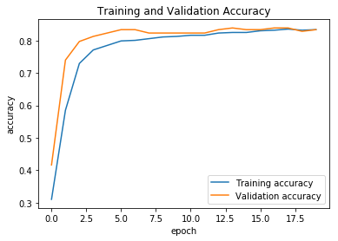
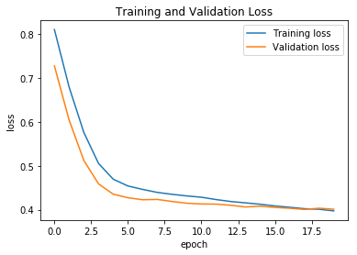
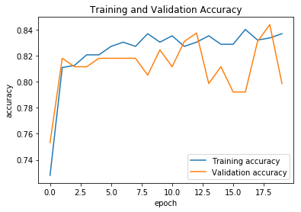
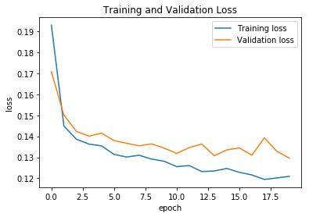
Mammography fully connected NN : good fit
Mammography CONV1D : seems like a good fit but can get into overfitting if run for a longer epochs

Slide 12
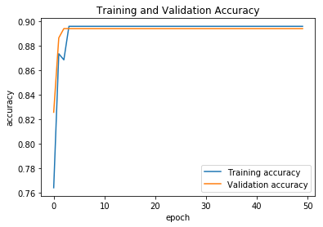
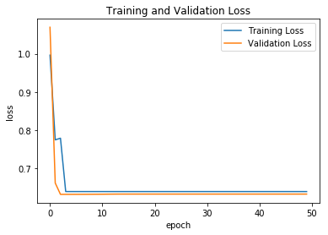
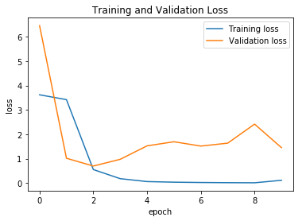
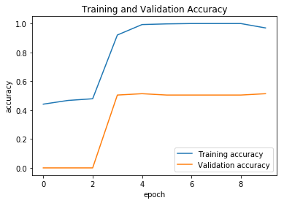
RNA dataset Fully connected : good fit
RNA dataset CONV1d The model is overfitting
I feel my model is complex for the dataset.
And many features less rows to train

Slide 13
Challenges Faced
The RNA-seq Gene dataset is rich in feature space has 20532 features a normal panda correlation wouldn’t work.
Hence had to perform ANOVA test to find correlation and remove features.
The multiclass dataset had imbalance and hence the normal train_test_split wouldn’t work . Had to write my own stratification function.
Used SMOTE to overcome imbalance but didn’t improve my f1_score much
My Conv 1D is overfitting, and since the data has 20532 features the parameters passed from one layer to another becomes too large. If I reduce the output space using filters, the model doesn’t learn much and colab gives up on RAM. I wanted to try auto encoders and feed the conv1 d didn’t get time.
I am not able to use OPTUNA for DL based models, I need to work on that.
Not able to do GridSearch on Multiclass , fails .

Slide 14
Learnings/Conclusions
Non-DL models have performed better than DL-models, I feel the reason could be limited rows of data for training.
Gene Data proves to be more accurate while classifying cancer. As of now within the scope of this project we can state that biopsy will classify/detect cancer almost 98% of the time correctly.
Mammography dataset along with the CAD we have applied shows good accuracy in detecting cancer, but it is not good as compared to using genome sequence.
If we can get more data, or augmented images from mammography. It might help in training our models well.

Slide 15
Thank you

